Slide 1


Joseph Ngota Chilo
14th December 2023

Slide 2

Outline
Executive Summary
Introduction
Methodology
Results
Conclusion
Appendix

Slide 3
Executive Summary
In order to estimate the costs of launching rockets to space, the ability to reuse the first stage is key. The aim of this project is to predict whether SpaceX will reuse the first stage of the rockets launched.
Publicly available data was collected using the SpaceX API and web scraping.
The data was explored and visualized using Matplotlib and SQL
Folium and Plotly Dash were leveraged to create the interactive plots and the dashboard.
Classification models were then trained on the data and tested on a hold out set.
The models had an accuracy score of 83.33% though logistic regression used the least time to run.

Slide 4
Introduction
In this commercial space age, companies are making space travel affordable for everyone.
Virgin Galactic is providing suborbital spaceflights.
Rocket Lab is a small satellite provider.
Blue Origin manufactures sub-orbital and orbital reusable rockets. Perhaps the most successful is SpaceX.
SpaceX’s accomplishments include:
Sending spacecraft to the International Space Station.
Starlink, a satellite internet constellation providing satellite Internet access.
Sending manned missions to Space.

Slide 5
Introduction
One reason SpaceX can do this is the rocket launches are relatively inexpensive.
SpaceX advertises Falcon 9 rocket launches on its website with a cost of 62 million dollars; other providers cost upwards of 165 million dollars each.
Much of the savings is because SpaceX can reuse the first stage.
Spaces X’s Falcon 9 launch like regular rockets.
However, SpaceX's Falcon 9 Can recover the first stage.
Sometimes the first stage does not land.
Sometimes it will crash.
Other times, Space X will sacrifice the first stage due to the mission parameters like payload, orbit, and customer.

Slide 6
Introduction
Problem we want to solve
Therefore the aim of this project is to determine if SpaceX will reuse the first stage by training a machine learning model.
This project uses public information to predict if SpaceX will reuse the first stage.

Slide 7

Section 1

Slide 8
Methodology
Executive Summary
Data collection was done in two ways.
Using an API
Web Scraping
Data wrangling was done using numpy and pandas python libraries
Exploratory data analysis (EDA) was done leveragin matplotlib visualizations and SQL explorations.
Interactive visual analytics were generated using Folium and Plotly Dash dashboards.
Multiple classification models were explored to find best performing model for predicting whether the first stage would be reused. Grid Search was leveraged for hyperparameter tuning and cross validation.

Slide 9
Data Collection
Methodology
Data collection was done in two ways.
Using an API
Web Scraping

Slide 10
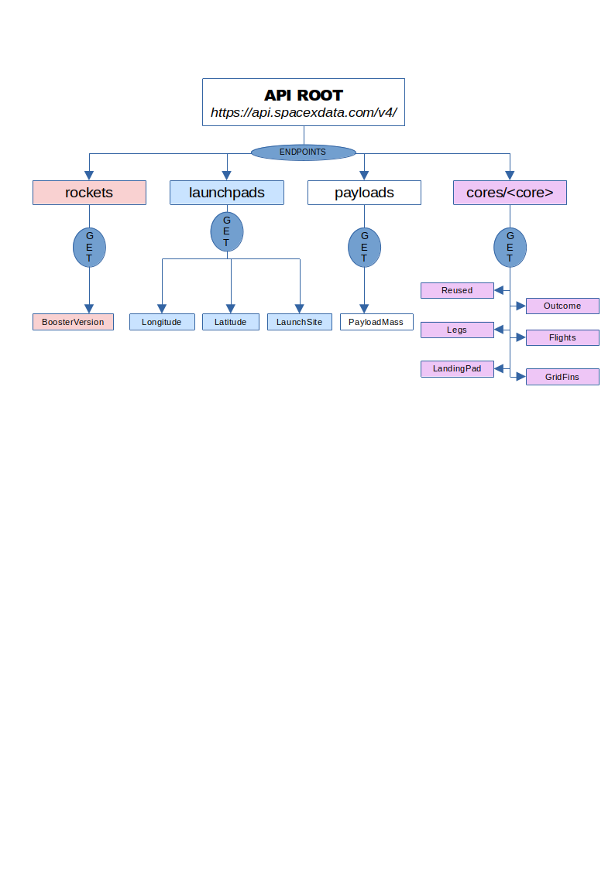
Data Collection – SpaceX API
Multiple endpoints were leveraged on the SpaceX API, (https://api.spacexdata.com/v4/), in order to get all the data required, as shown in the flowchart.
The notebook that leverages this API endpoints can be found on Github.

Slide 11
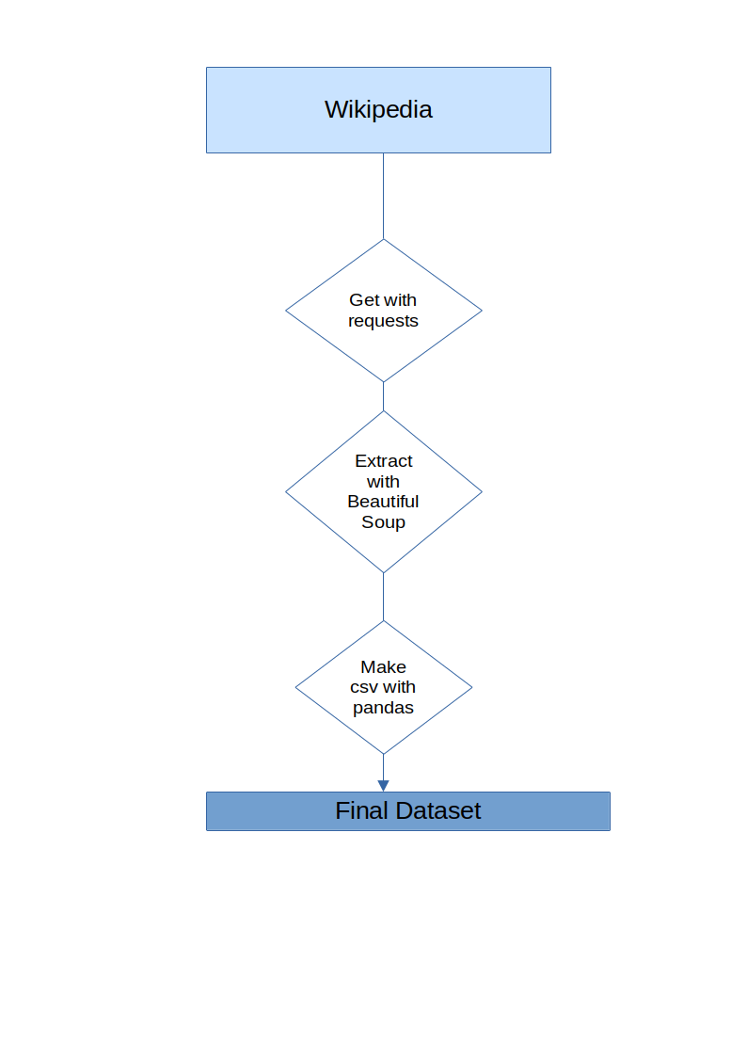
Data Collection - Scraping
Leveraging requests module and Beautiful Soup in Python, publicly available data was scraped from wikipedia
The notebook can be found on Github.

Slide 12
Data Wrangling
Wrangling of the collected data involved:
Checking for null values
Reviewing data types
Exploratory data analysis
Feature Engineering
40% of the LandingPad data was null.
Exploratory data analysis involved checking value counts of the launch site and finding the number of launches on each site
‘landing_class’ was defined from the Outcome feature
The data wrangling notebook can be found on Github.

Slide 13
EDA with Data Visualization
Scatter plots were used to:
check how FlightNumber (indicating the continuous launch attempts.) and Payload variables would affect the launch outcome.
visualize the relationship between Flight Number and Launch Site
Visualize the relationship between Payload and Launch Site
Visualize the relationship between FlightNumber and Orbit type
A bar chart was used to visualize the relationship between success rate of each orbit type
The EDA notebook can be found on Github.

Slide 14
EDA with SQL
Queries were performed to identify the following:
Display the names of the unique launch sites in the space mission
Display 5 records where launch sites begin with the string 'CCA'
Display the total payload mass carried by boosters launched by NASA (CRS)
Display average payload mass carried by booster version F9 v1.1
List the date when the first succesful landing outcome in ground pad was acheived.
List the names of the boosters which have success in drone ship and have payload mass greater than 4000 but less than 6000
List the total number of successful and failure mission outcomes¶
List the names of the booster_versions which have carried the maximum payload mass. Use a subquery
List the records which will display the month names, failure landing_outcomes in drone ship ,booster versions, launch_site for the months in year 2015.
Rank the count of successful landing_outcomes between the date 04-06-2010 and 20-03-2017 in descending order.
The EDA with SQL notebook can be found on Github.

Slide 15
Build an Interactive Map with Folium
Leveraging folium, the following was done:
Marking of all launch sites on a map
Marking the success/failed launches for each site on the map
Calculating the distances between a launch site to its proximities
The folium notebook can be found on Github.

Slide 16
Build a Dashboard with Plotly Dash
A dashboard was built using Plotly Dash with the following components
Launch Site Drop-down Input Component
A callback function to render success-pie-chart based on selected site dropdown
A Range Slider to Select Payload
A callback function to render the success-payload-scatter-chart scatter plot
These components were added to improve interactivity and ease of understanding the dashboard.

Slide 17
Predictive Analysis (Classification)
The feature Class ,representing whether the first stage was reused or not, was our target variable.
All other features were used as features in our model.
Train Test Split was used to split our data into train and test sets.
The following models were trained and tested on the data.
K nearest neighbors
Decision tree classifier
Support vector machine
Logistic regression
Grid Search CV was utilised for hyperparameter tuning and cross-validation

Slide 18
Results
EDA identified that:
Different launch sites have different success rates. CCAFS LC-40, has a success rate of 60 %, while KSC LC-39A and VAFB SLC 4E has a success rate of 77%.
With heavy payloads the successful landing or positive landing rate are more for Polar,LEO and ISS.
in the LEO orbit the Success appears related to the number of flights; on the other hand, there seems to be no relationship between flight number when in GTO orbit.
for the VAFB-SLC launchsite there are no rockets launched for heavypayload mass(greater than 10000)
While the models had different train accuracies, they had a similar test accuracy of 83.33%

Slide 19

Section 2

Slide 20
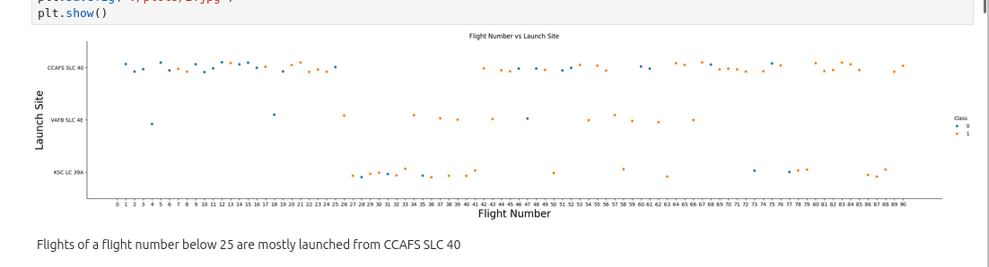
Flight Number vs. Launch Site

Slide 21
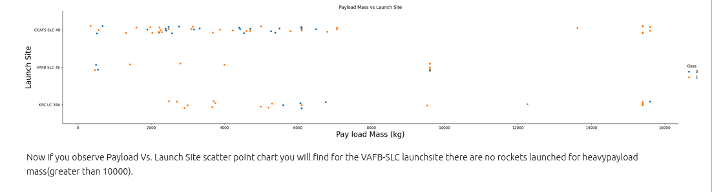
Payload vs. Launch Site

Slide 22
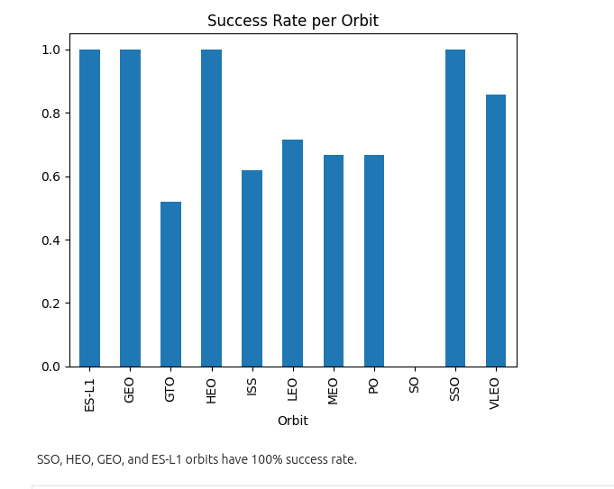
Success Rate vs. Orbit Type

Slide 23
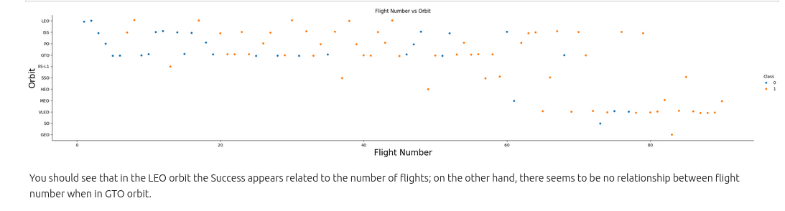
Flight Number vs. Orbit Type

Slide 24
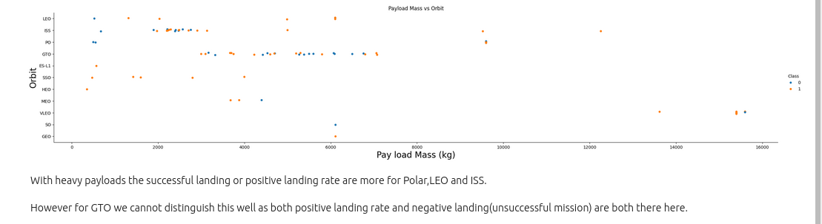
Payload vs. Orbit Type

Slide 25
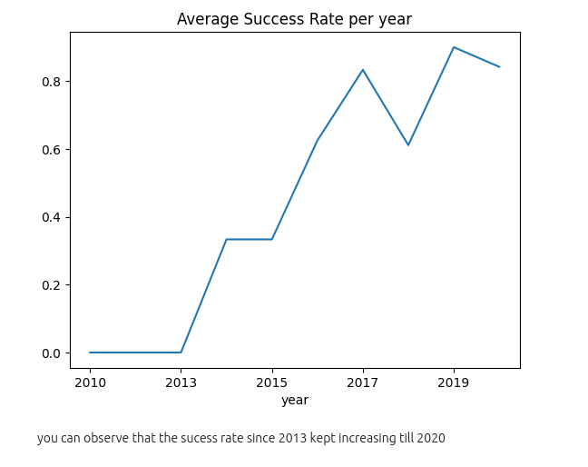
Launch Success Yearly Trend

Slide 26
All Launch Site Names
The query used was
SELECT DISTINCT(Launch_Site) FROM SPACEXTB
The result was the distinct launch site names. i.e.,
CCAFS LC-40
VAFB SLC-4E
KSC LC-39A
CCAFS SLC-40

Slide 27
Launch Site Names Begin with 'CCA'
5 records where launch sites begin with `CCA` were identified
The query used was:
SELECT * from SPACEXTBL where Launch_Site like ("CCA%") LIMIT 5
A sample of the results:
Date | Time (UTC) | Booster_Version | Launch_Site | Payload | PAYLOAD_MASS__KG_ | Orbit | Customer | Mission_Outcome | Landing_Outcome
6/4/2010 | 18:45:00 | F9 v1.0 B0003 | CCAFS LC-40 | Dragon Spacecraft Qualification Unit | 0 | LEO | SpaceX | Success | Failure (parachute)
12/8/2010 | 15:43:00 | F9 v1.0 B0004 | CCAFS LC-40 | Dragon demo flight C1, two CubeSats, barrel of Brouere cheese | 0 | LEO (ISS) | NASA (COTS) NRO | Success | Failure (parachute)

Slide 28
Total Payload Mass
The total payload carried by boosters from NASA was calculated
The query used:
SELECT SUM(PAYLOAD_MASS__KG_) as 'Total Mass in kg' from SPACEXTBL where Customer is 'NASA (CRS)'
The total payload mass was found to be 45,596 kg.

Slide 29
Average Payload Mass by F9 v1.1
The average payload mass carried by booster version F9 v1.1 was calculated
The query used was
SELECT AVG(PAYLOAD_MASS__KG_) as 'Average Mass in kg' from SPACEXTBL where Booster_Version is 'F9 v1.1'
The average payload mass was found to be 2928.4kg

Slide 30
First Successful Ground Landing Date
The date of the first successful landing outcome on ground pad was identified.
The query used was:
SELECT min(Date) from SPACEXTBL where Landing_Outcome = 'Success (ground pad)'
The date was found to be 2015-12-22

Slide 31
Successful Drone Ship Landing with Payload between 4000 and 6000
The names of boosters which have successfully landed on drone ship and had payload mass greater than 4000 but less than 6000:
F9 FT B1022
F9 FT B1026
F9 FT B1021.2
F9 FT B1031.2
The query used:
SELECT DISTINCT(Booster_Version) from SPACEXTBL where Landing_Outcome = "Success (drone ship)" and PAYLOAD_MASS__KG_ between 4000 and 6000

Slide 32
Total Number of Successful and Failure Mission Outcomes
Only 1 mission outcome was categorized as failure with 100 successful.
The queries used was:
SELECT count(Mission_Outcome) as 'failed' from SPACEXTBL where Mission_Outcome = 'Failure (in flight)'
SELECT count(Mission_Outcome) as 'successful' from SPACEXTBL where Mission_Outcome != 'Failure (in flight)'

Slide 33
Boosters Carried Maximum Payload
The following boosters carried the maximum payload:
F9 B5 B1048.4, F9 B5 B1049.4, F9 B5 B1051.3, F9 B5 B1056.4, F9 B5 B1048.5, F9 B5 B1051.4, F9 B5 B1049.5, F9 B5 B1060.2, F9 B5 B1058.3, F9 B5 B1051.6, F9 B5 B1060.3, F9 B5 B1049.7
The query used was:
SELECT Booster_Version from SPACEXTBL where PAYLOAD_MASS__KG_ = (select max(PAYLOAD_MASS__KG_) from SPACEXTBL)

Slide 34
2015 Launch Records
The failed landing_outcomes in drone ship, their booster versions, and launch site names for in year 2015 are shown in the table
The query used:
SELECT substr(Date, 6, 2) as month, Landing_Outcome, Booster_Version, Launch_Site from SPACEXTBL where substr(Date,0,5) = '2015' and Landing_Outcome = 'Failure (drone ship)'
month | Landing_Outcome | Booster_Version | Launch_Site
01 | Failure (drone ship) | F9 v1.1 B1012 | CCAFS LC-40
04 | Failure (drone ship) | F9 v1.1 B1015 | CCAFS LC-40

Slide 35

Section 3

Slide 36
<Folium Map Screenshot 1>
Replace <Folium map screenshot 1> title with an appropriate title
Explore the generated folium map and make a proper screenshot to include all launch sites’ location markers on a global map
Explain the important elements and findings on the screenshot

Slide 37
<Folium Map Screenshot 2>
Replace <Folium map screenshot 2> title with an appropriate title
Explore the folium map and make a proper screenshot to show the color-labeled launch outcomes on the map
Explain the important elements and findings on the screenshot

Slide 38
<Folium Map Screenshot 3>
Replace <Folium map screenshot 3> title with an appropriate title
Explore the generated folium map and show the screenshot of a selected launch site to its proximities such as railway, highway, coastline, with distance calculated and displayed
Explain the important elements and findings on the screenshot

Slide 39

Section 4

Slide 40
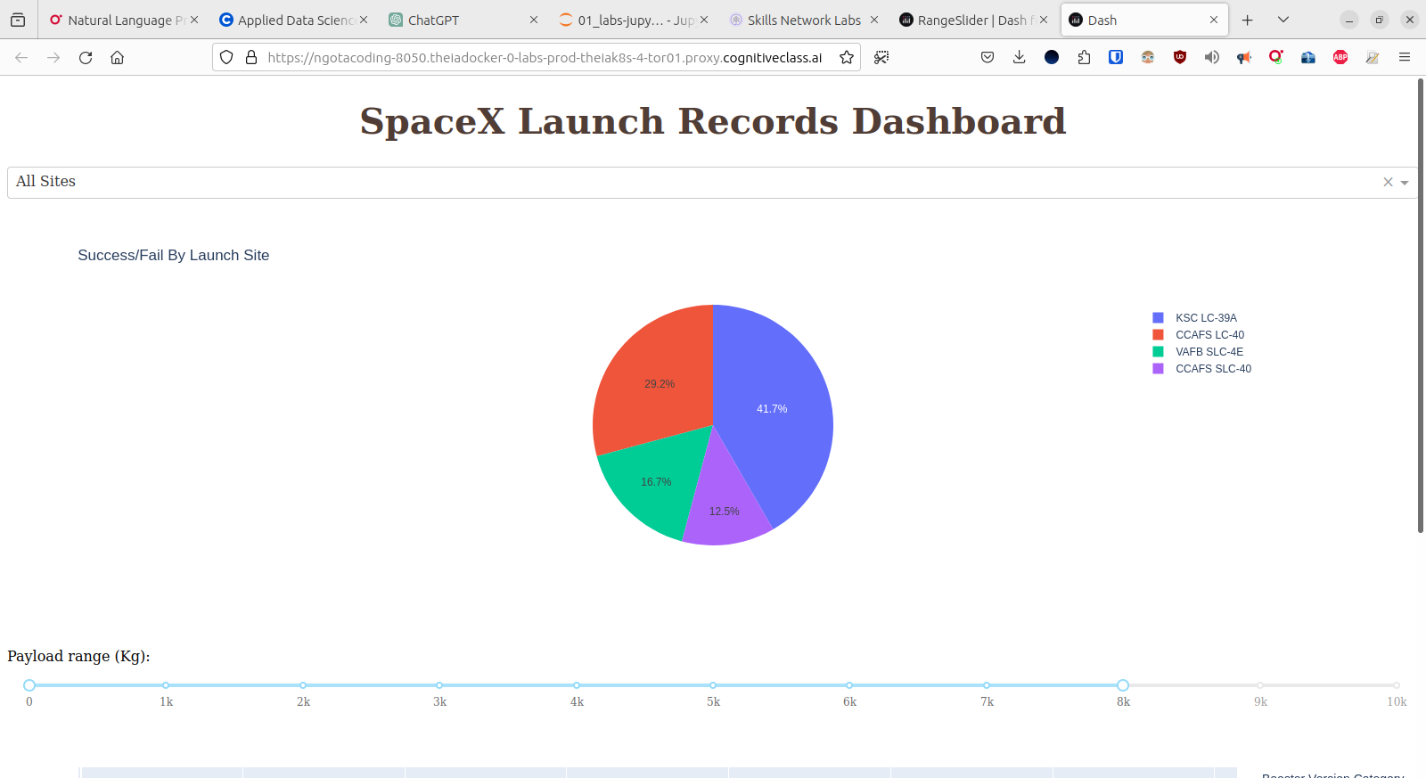
SpaceX Launch Records Dashboard

Slide 41
Highest Launch Success Ratio

Slide 42
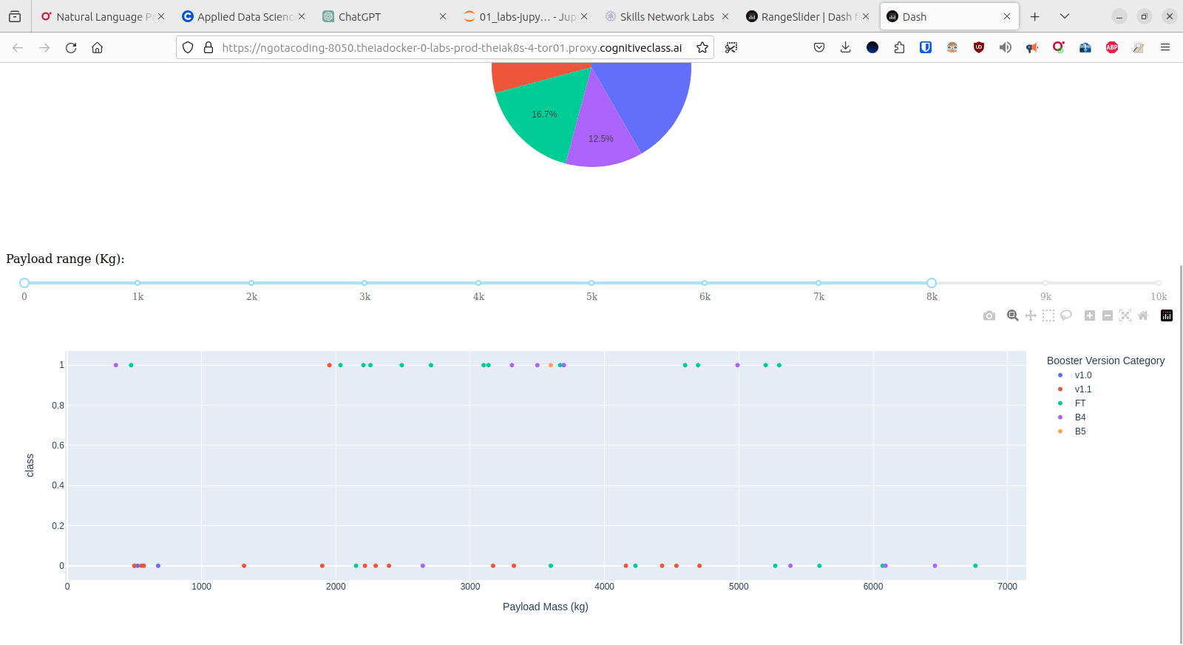
Payload Vs Launch Outcome

Slide 43

Section 5

Slide 44
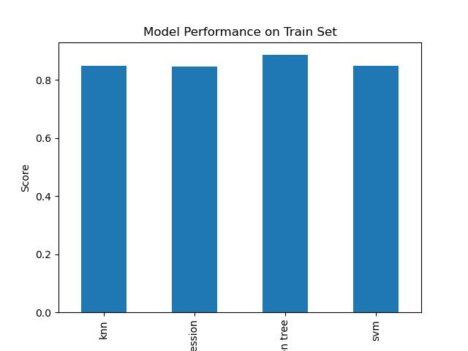
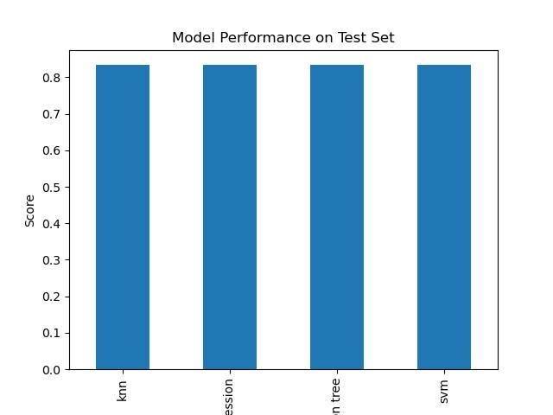
Classification Accuracy

Slide 45
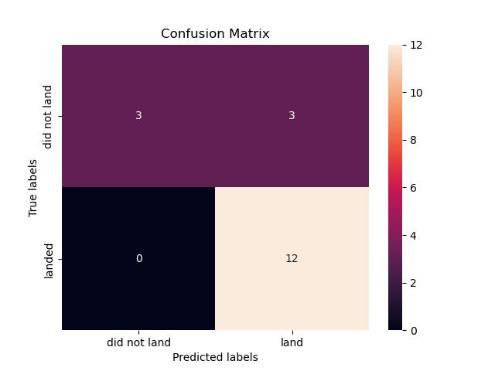
Confusion Matrix

Slide 46
Conclusions
All models had a similar test accuracy score of 83.33%.
Decision Tree Classifier was the best performing model on the train set with an accuracy score of 88%
We had 3 False positives reported.
Because our requirement is a model that is able to accurately predict whether the first stage or not, this models are suitable.
Logistic Regression will therefore be used because it has uses the minimal time to run on the selected data.

Slide 47


